Slide 1
20Su3 FMC Wheelchair Project
Team member:Simeng Cai, Jialan Sun,Jiaxing Wang,Zhenkai Xia,Haoran Yin

Slide 2
Project Description
Description: Improving wheelchairs according to client’s requirement
Project aim to solve:
1.Improved brakes and anti-theft devices for wheelchairs
2.Adjustable calf support
3.Controlled leg support
Sponsor：Hopspital and school project manager
Impact of project success
presenter:Jialan Sun

Slide 3
Background/Current State-of-the-art
Existing approaches:
Using suitable damper to prevent free falling
Put the brake device in the proper position
Reference:
[1] 2. M. C. H. Y. A. C. C. L. a. Y. Z. Cheng Fang 1, "Feasibility study of shape memory alloy ring spring systems for self-centring seismic resisting devices," Smart Materials and Structures, no. 6, 2015
[2] Wikipedia, "Wikipedia," 23 3 2020. [Online]. Available: https://en.wikipedia.org/wiki/Shock_absorber#Vehicle_suspension. [Accessed 3 7 2020].
presenter:Simeng Cai

Slide 4
existing designs and Shortcomings
Existing designs
Using rotary damper
Setting brake system at the rear handle and the big wheel (like bicycle)
Shortcomings
1): The rotary damper is not completely reliable over a project’s lifetime.
2): The speed of the wheelchair is slow, the patient may not consider the function of the brake
Presenter: Simeng Cai

Slide 5
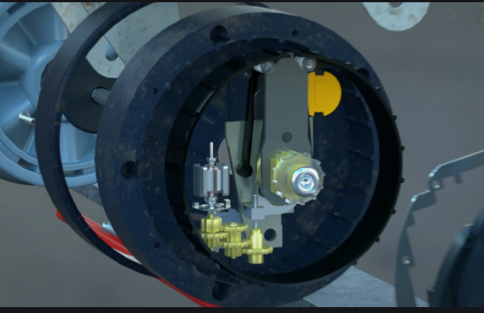
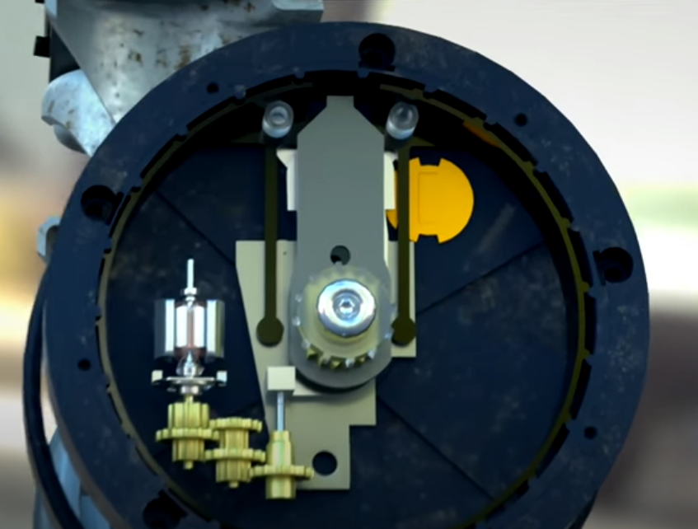
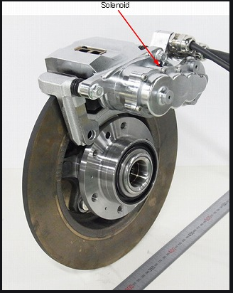
Ideas from completely different applications
Figure 1
Figure 2
Figure 3
Shopping cart anti-theft mechanism
Ideal anti-theft mechanism for wheelchairs
Presenter: Simeng Cai

Slide 6
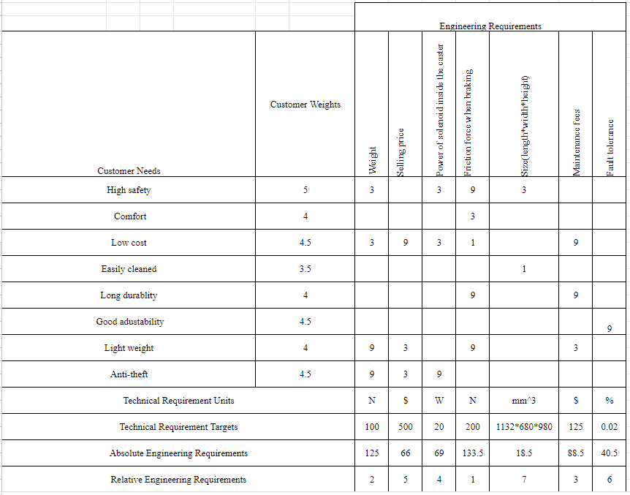
Customer Requirements and Engineering Requirements
Table 1: QFD
Presenter: Zhenkai Xia

Slide 7
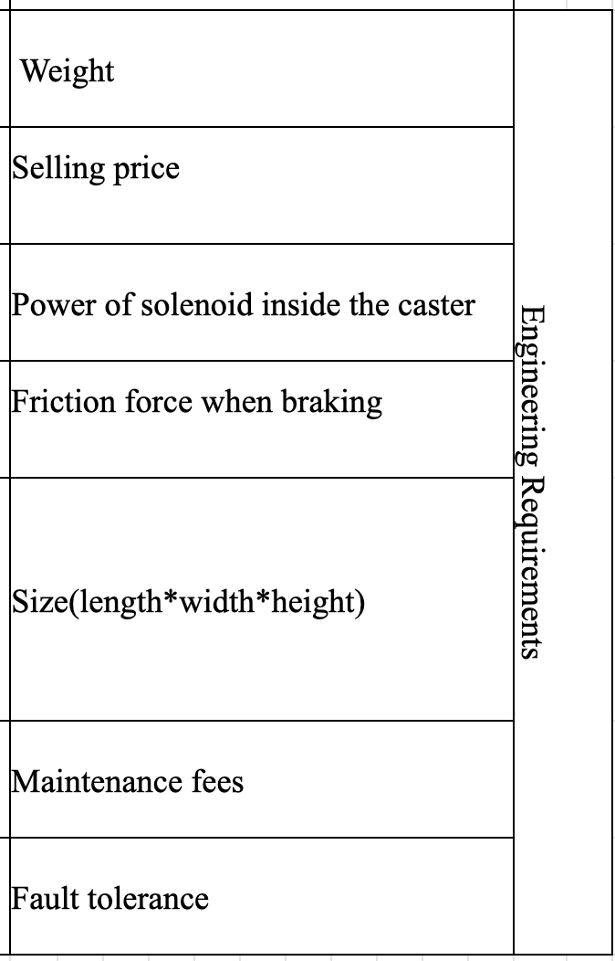
Customer Requirements and Engineering Requirements
Three Most Important ERs
Friction force when braking (N)
Fault tolerance (%)
Weight (N)

Slide 8
Concept Generation and Skills Acquired
Preferred concepts 1：calf pad
Back-up concepts 1：calf strip，calf panel
Preferred concept 2：·Rotary dampers
Back-up concepts 2: Hysteresis of structural material damper
Self-learning application:
1. Explore damper mechanism and different kinds of dampers. Could choose the right damper to apply in different occasions.
2. Solenoid (generating a magnetic field through a solenoid, attracting each other with other magnetic materials)
Method used to choose preferred concepts：Morph Matrix&Decision Matrix
presenter:Haoran Yin

Slide 9
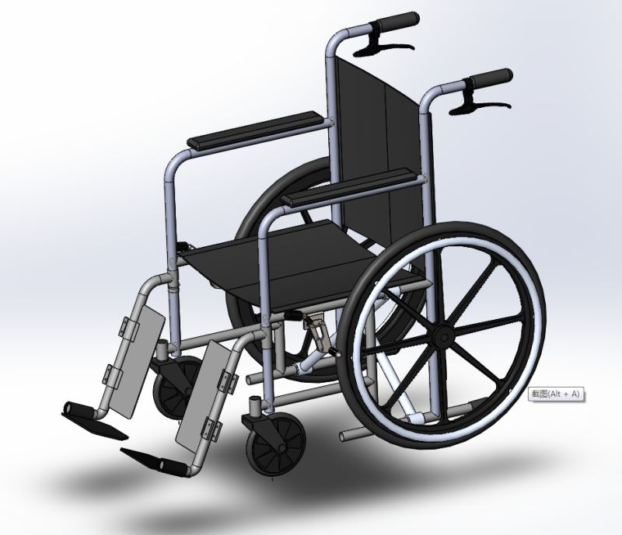
Concept Evaluation
Size: Length 1132 mm
Width 680 mm
Height 980 mm
presenter:Jiaxin Wang

Slide 10
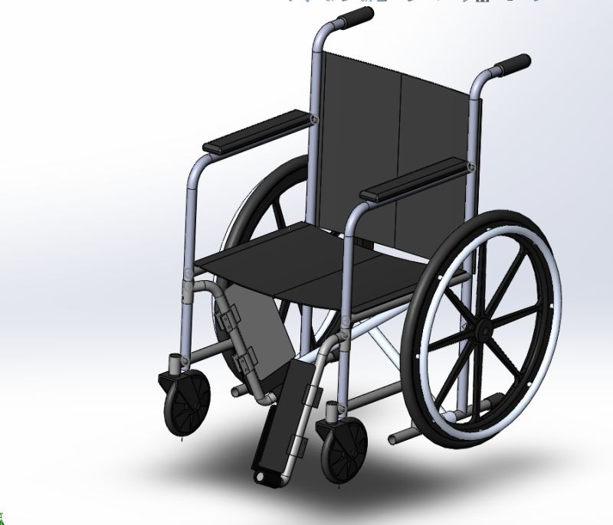
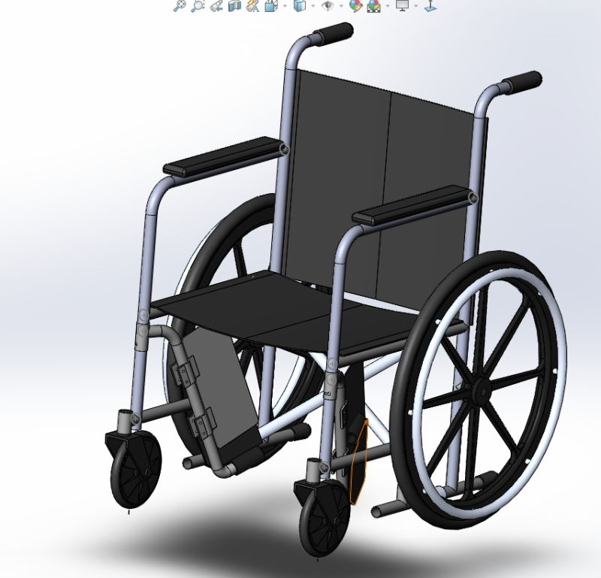
Calf pad
presenter:Jiaxin Wang

Slide 11
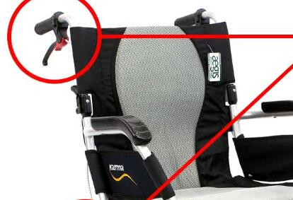
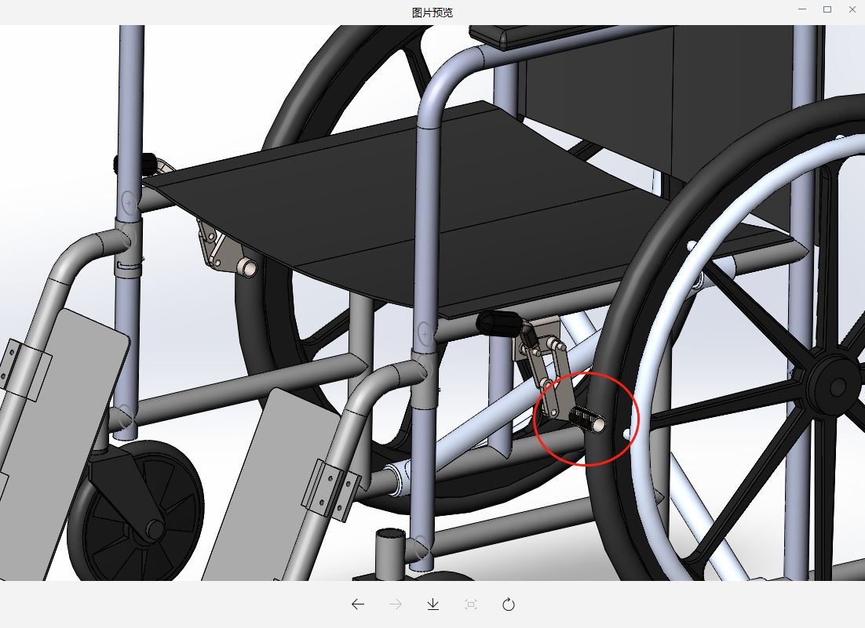
Brake reduce
presenter:Jiaxin Wang

Slide 12
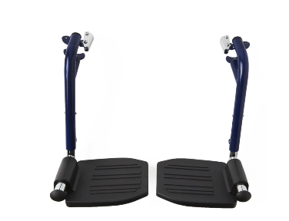
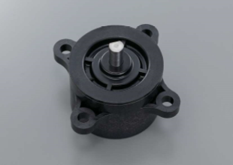
Leg support
presenter:Jiaxin Wang

Slide 13
Q&A

